Slide 1
Capstone Project
Team 1
Amardeep
Rebecca
Bartholomew
Sobona

Slide 2
Intro - Data Structure
Demographics
Product Performance
Sales Website Activity
Inventory

Slide 3
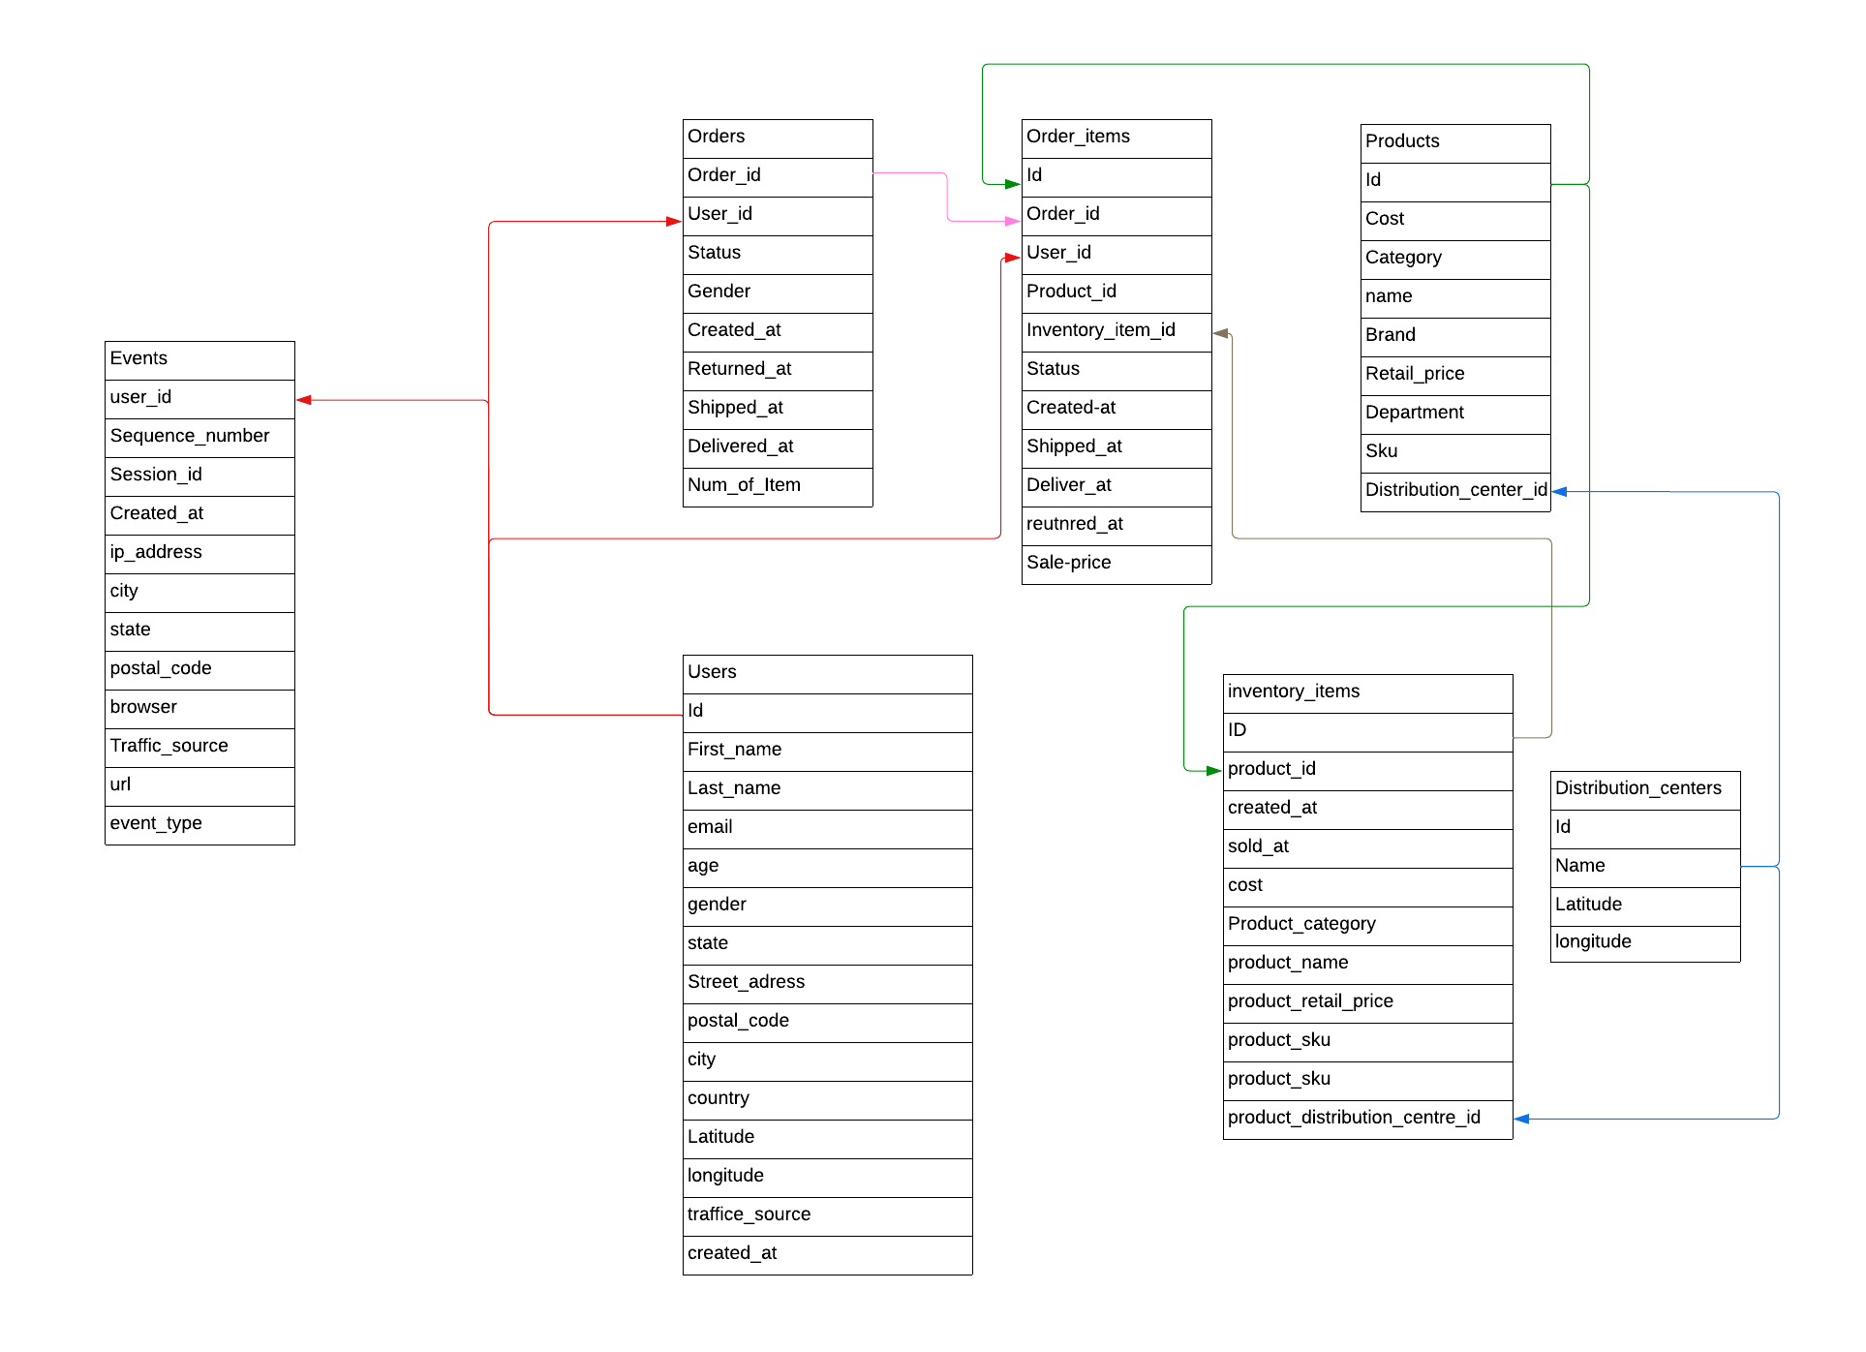
Data Scheme

Slide 4
Demographics

Slide 5
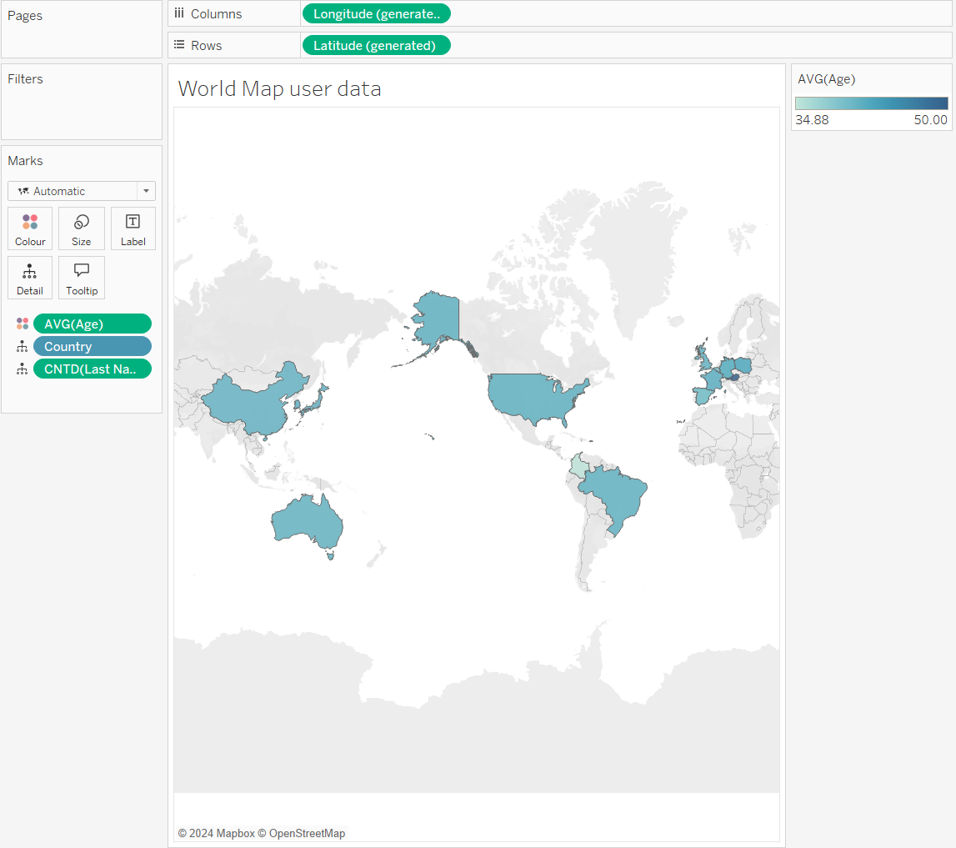
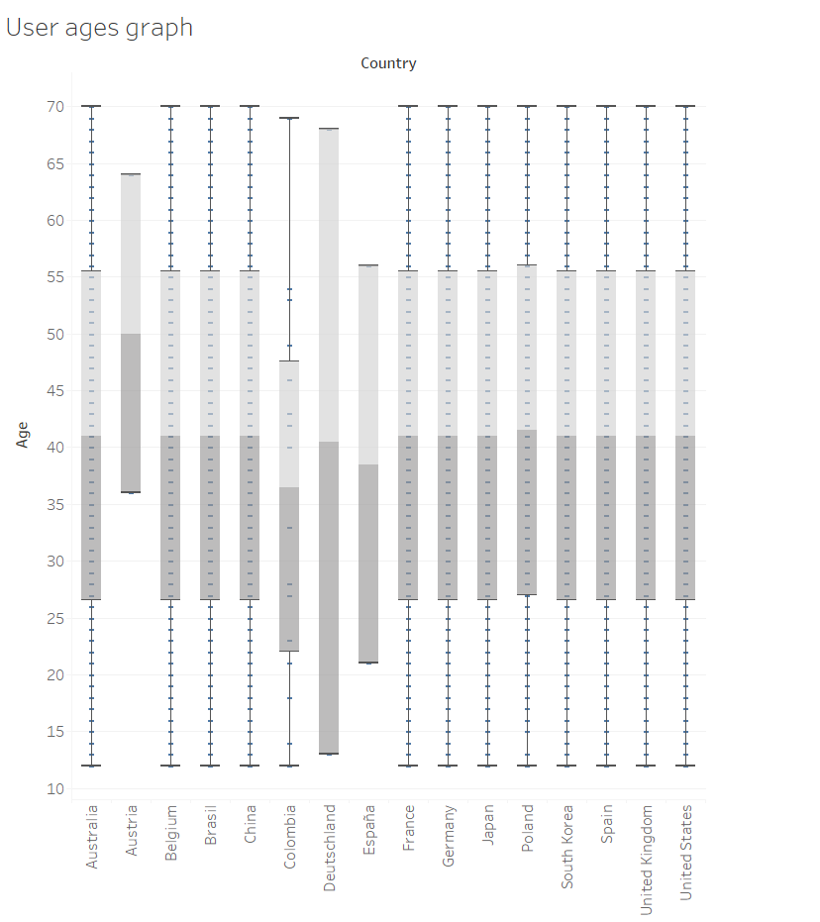

Slide 6
Product Performance

Slide 7
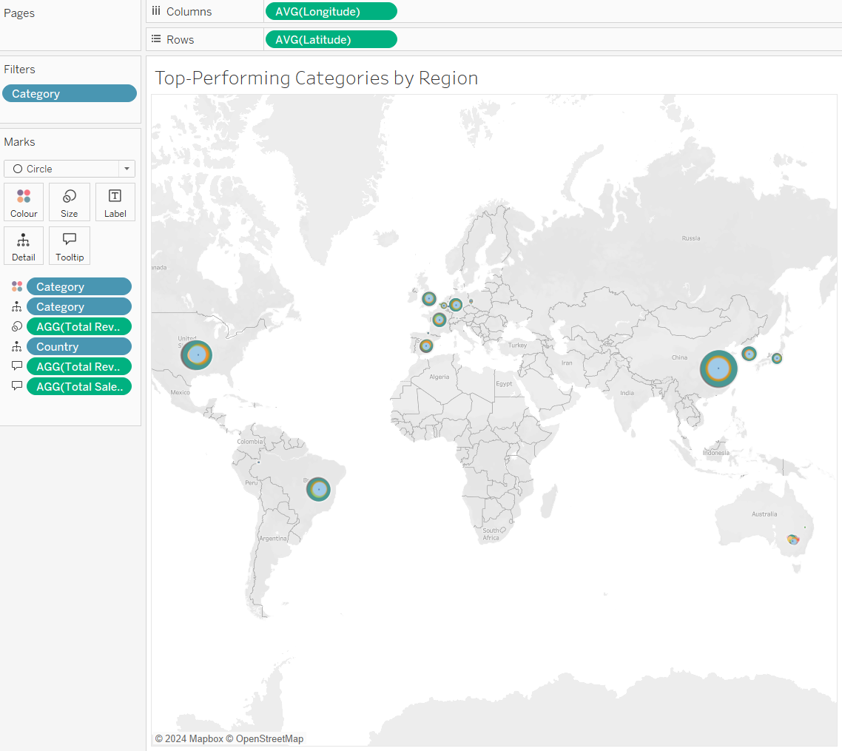

Slide 8
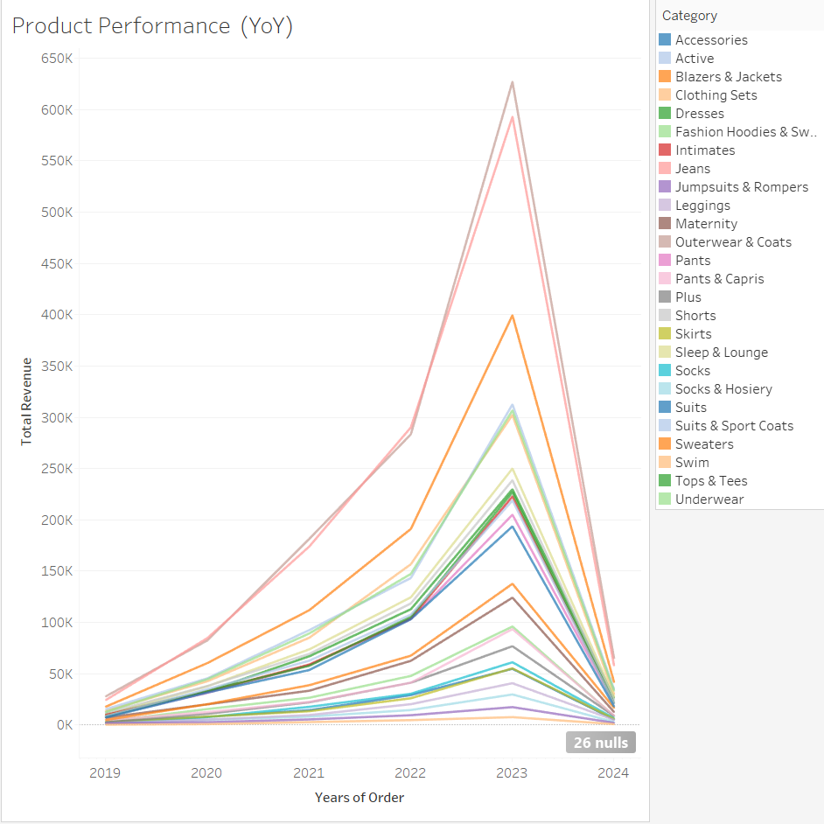

Slide 9
Sales Website Activity

Slide 10
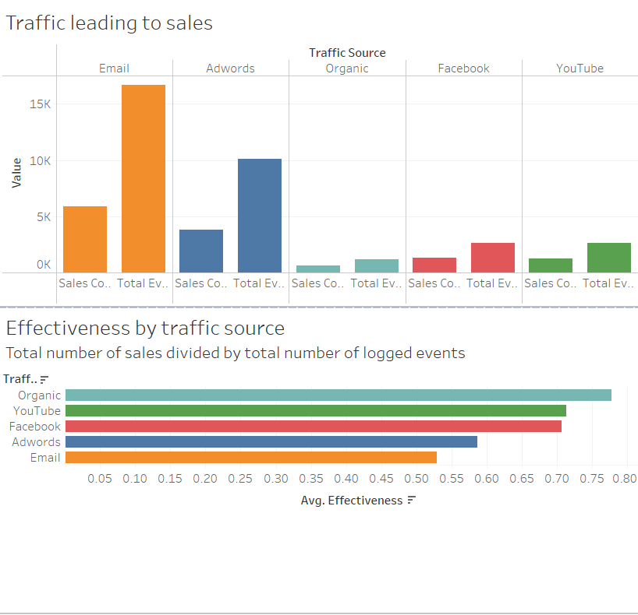

Slide 11
Inventory

Slide 12
